Slide 1
AZ-300T02 M 2: Implementing and Managing Application Services
Deploying Web Apps
Managing Web Apps
App Service Security
Serverless Computing Concepts
Managing Azure Functions
Managing Logic App

Slide 2
Lesson 1: Deploying Web Apps
Web App Features
What is Continuous Development?
Staging Environments in App Service
Add a Deployment Slot
Swap Deployment Slots
Demonstration: Deploying to a Stage Slot
Enabling Continuous Deployment
Demonstration: Continuous Deployment
Video: Managing App Setting and Connection Strings
Practice: Deployment Slots
Web App Templates

Slide 3
Web App Features
Service included in the App Service offering, which provides:
Multiple languages and frameworks
DevOps optimization
Global scale with high availability
Connections to SaaS platforms and on-premises data
Security and compliance
Application templates
Visual Studio integration
API and mobile features
Serverless code

Slide 4
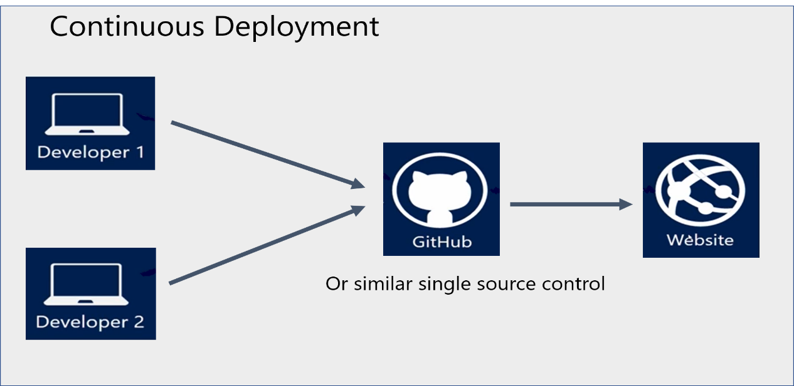
What is Continuous Development?
Automatic publishing of updates to source control code:
Visual Studio Team Services
Bitbucket
GitHub
Git
and many others…

Slide 5
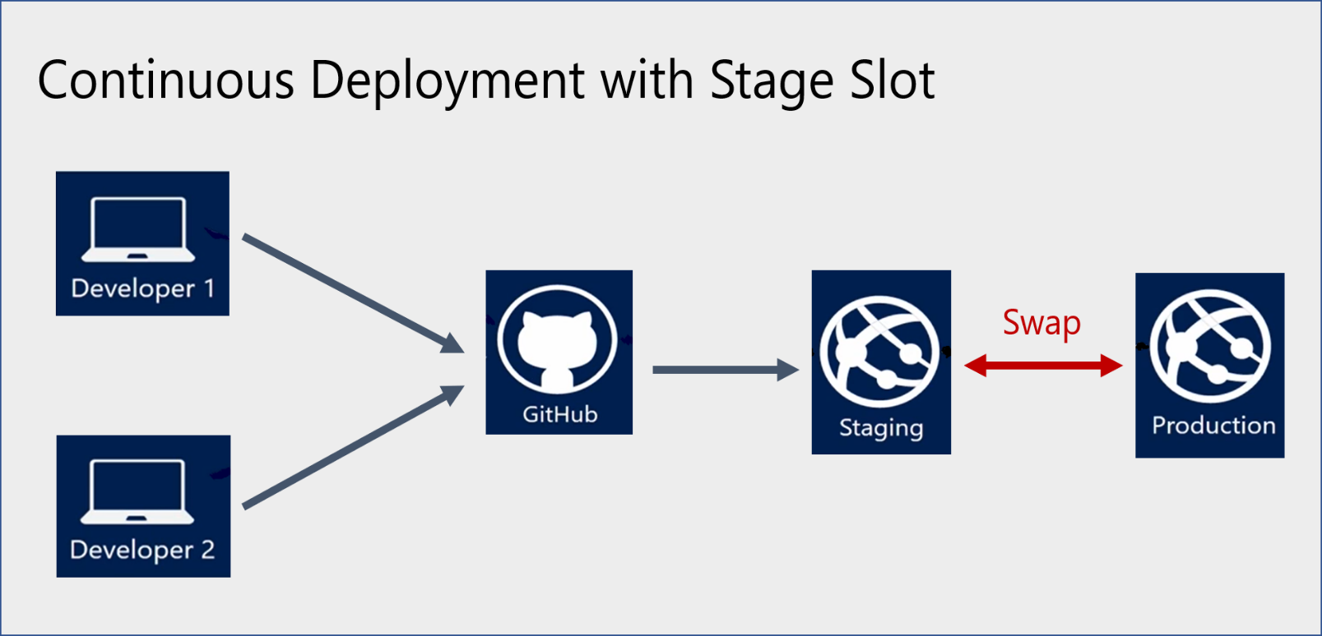
Staging Environments in App Service
A separate deployment slot of App Service services:
Supported by web apps, mobile apps, and API apps
Requires a higher pricing tier:
Standard
Premium
Isolated
Offers a number of benefits:
Additional validation of app changes
Slot warming before swap
Support for auto-swap
Immediate rollback

Slide 6
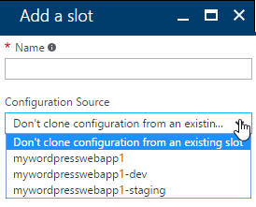
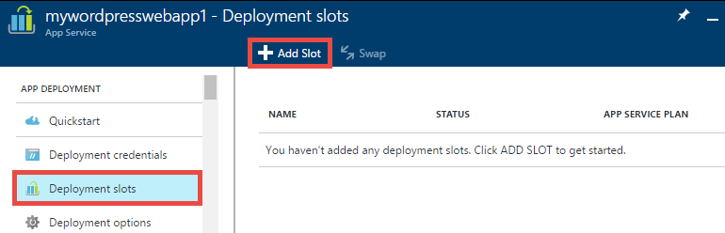
Add a Deployment Slot
The operation can be performed directly from the Azure portal
Slot cloning:
For the first slot:
you can clone the production slot
For subsequent slots:
you can clone any existing slots

Slide 7
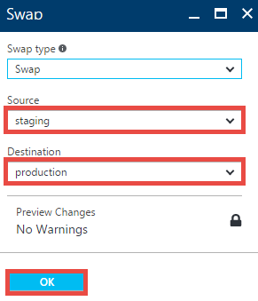
Swap Deployment Slots
There are three types of slot swapping settings:
Settings that are not swapped:
publishing endpoints, custom domain names, SSL certificates and bindings, scale settings, WebJob schedulers.
Settings that are swapped:
general settings, handler mappings, monitoring, diagnostics, and WebJobs.
Settings that are configurable (either swapped or not swapped):
App settings and connection strings.

Slide 8
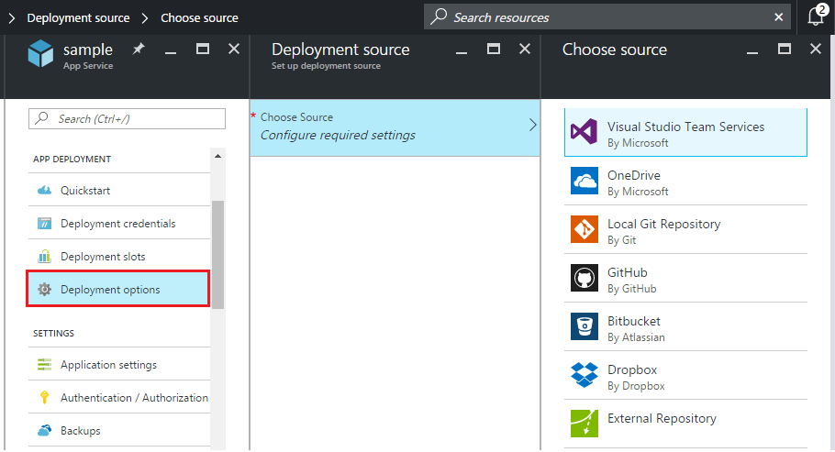
Enabling Continuous Deployment
Configurable from the Azure portal:
VSTS
OneDrive
Local Git
GitHub
Bitbucket
Dropbox
External Repository

Slide 9
Practice: Deployment Slots
Notes:
Show this if you prefer or make the delegates do them as homeworks

Slide 10

Web App Templates
Azure Resource Manager templates for:
Deploying a Windows-based web app:
Configuring a Windows-based web app:
Deploying and configuring a Linux-based web app
Deploying web apps with connected resources (e.g. an Azure SQL Database)
Creating App Service Environment v2

Slide 11
Lesson 2: Managing Web Apps
Video: Management Tools and Options
Video: Managing App Settings Overview
Video: Managing General App Settings
Backup Your App
Restore a Backup
Restore a Snapshot
Cloning an App
Practice: Azure Backup and Restore

Slide 12

Backup Your App
To configure Azure web app backups, provide:
1. Backup storage which designates backup destination:
Azure Storage account and container
2. Backup database (in scenarios where the web app uses a back-end database):
The database must be referenced in the connection strings of the web app
The backup supports Azure SQL Database, Azure Database for MySQL, Azure Database for PostgreSQL, and MySQL in-app
3. Backup schedule (in order to automate backups)

Slide 13
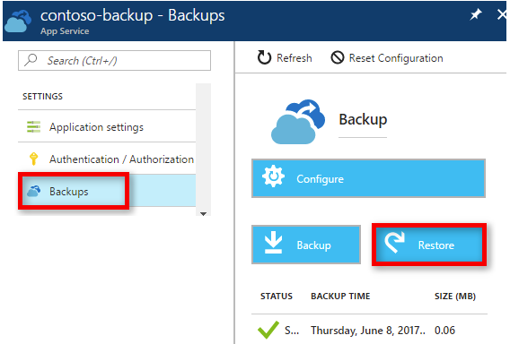

Restore a Backup
Available from the Azure portal
Included in higher pricing tiers:
Standard
Premium
Requires designating:
Restore source:
Any backup of the current web app
Any web app backup in Azure Storage
Restore destination:
An existing web app
A new web app

Slide 14
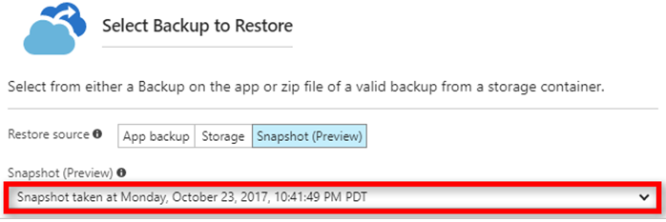
Restore a Snapshot
Automatic, incremental shadow copies of a web app:
Requires the Premium pricing tier
Is a subject to a number of constraints:
You can only restore to the same app or to a slot belonging to that app.
App Service stops the target app or target slot during the restore.
App Service keeps three months’ worth of snapshots for platform data recovery purposes.
You can only restore snapshots from the last 30 days.
Offers several benefits:
No file copy errors due to file locks.
No storage size limitation.
No configuration required

Slide 15
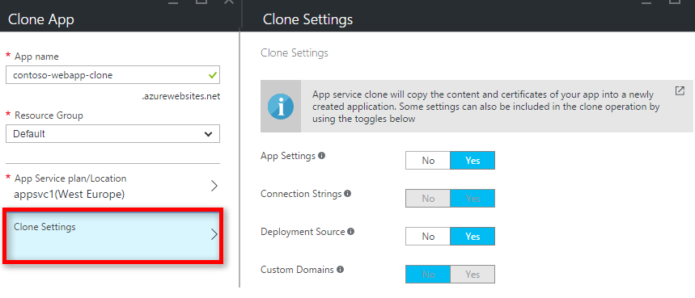
Cloning an App
Creates a replica of a web app in the same or a different region:
Requires the Premium pricing tier
Allows selecting settings to clone, including:
Connection strings
Deployment source
Custom domains
Does not include:
Auto scale settings
Backup schedule
VNET settings
Auth settings
Kudu Extensions
TiP rules
Database content
App Insights

Slide 16
Lesson 3: App Service Security
Video: App Security Features Overview
App Service Security Levels
Application Security
App Service Authentication
Authentication Providers
Video: App Service Authentication Options
Demonstration: Authentication and Authorization Features
Demonstration: App Service Security Features
Video: App Service Isolation Overview
Demonstration: App Service Isolation

Slide 17

App Service Security Levels
Infrastructure and platform security:
Controlled by the Azure platform
Includes compute, storage, network, web frameworks, integration features, etc.
Involves continuous security and compliance checks:
App Service apps are isolated from both the Internet and from the other customers' Azure resources.
Communication of secrets between App Service apps and other Azure resources does not cross network boundaries and is always encrypted.
Communication between App Service apps and external resources, such as PowerShell, Azure CLI, Azure SDKs, REST APIs, and hybrid connections, is properly encrypted.
24-hour threat management protects App Service resources from malware, distributed denial-of-service (DDoS), man-in-the-middle (MITM), and other threats.
Application security:
Controlled by customers
Includes Azure AD integration, certificate management, secure communication, etc.

Slide 18
Application Security
Customers are responsible for:
Developing, deploying, and managing App Service code and content in a secure way
Protecting apps from cyber threats such as:
SQL Injection
Session hijacking
Cross-site-scripting
Application level Man-In-the-Middle (MITM) attacks

Slide 19
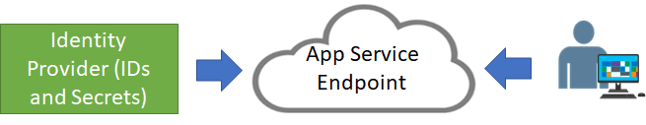
App Service Authentication
Relies on a trust relationship with an identity provider (IdP):
You select an identity provider for your App Service app
The identity provider handles authentication and generates authentication token
The App Service app validates token assertions and authorizes access to its resources
Cookies, JWTs, and bearer tokens validate access for the duration of a session
Directs authentication requests to an authentication endpoint
Includes built-in supports for the most popular identity providers

Slide 20
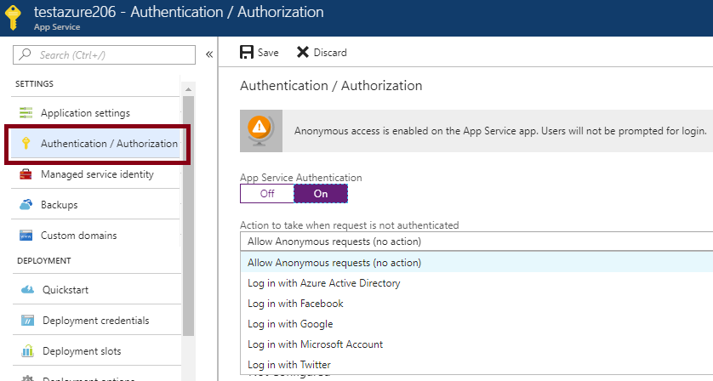
Authentication Providers
Configurable directly from the Azure portal:
Relies on the Authentication/Authorization feature
Uses federated identity
Offers built-in support for:
Azure AD
Facebook
Google
Microsoft Account
Twitter

Slide 21
Lesson 5: Implement Autoscaling rules and patterns
Computing patterns
Scale and auto-scale
Auto-scale metrics

Slide 22
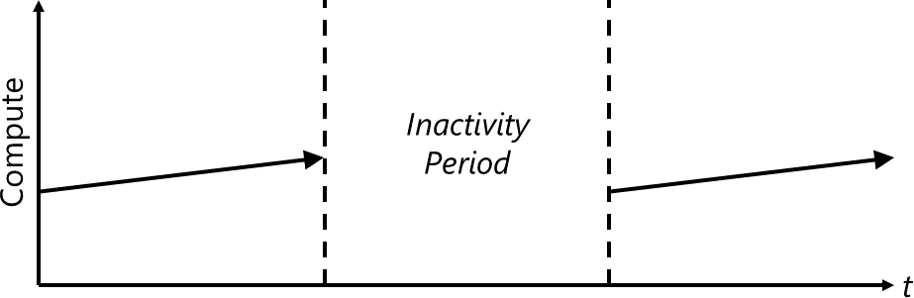
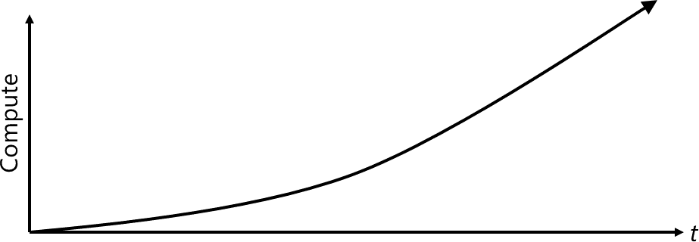
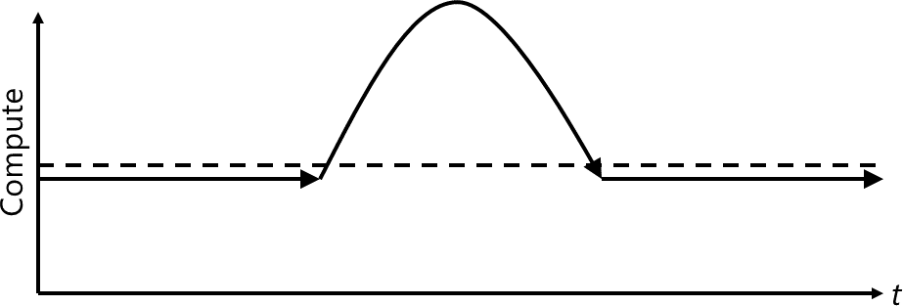
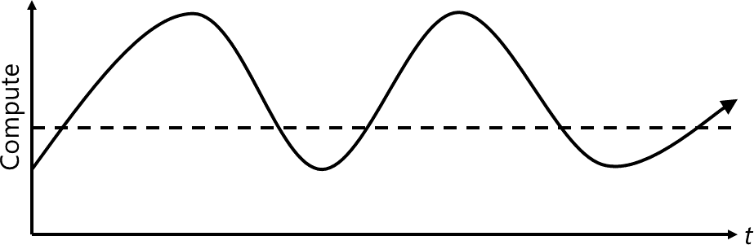
Computing patterns
The most common computing patterns for cloud-based web apps:
On and off:
Common for batch processing
Waste of overprovisioned capacity
Growing fast:
Represents a successful service
Presents growth challenges
Unpredictable bursting:
Unexpected peaks of demand
Waste of overprovisioned capacity
Predictable bursting:
Requires resource provisioning and deprovisioning
Introduced increased management complexity

Slide 23
Scale and auto-scale
Cloud offers elastic scaling by using its practically unlimited resources
Auto-scaling is the ability to monitor workload usage and automatically scale according to changes in usage levels
Many Azure services support manual and automatic scaling:
infrastructure services such as Azure Virtual Machine Scale Sets
application services such as Azure App Service
database services such as Azure Cosmos DB.

Slide 24
Auto-scale metrics
App Service support autoscale:
Requires service plans using Basic, Standard, or Premium pricing tiers
Increases or decreases the instance count within the same service plan
Supports a number of auto-scale metrics:
CPU: CpuPercentage
Memory: MemoryPercentage
Data in: BytesReceived
Data out: BytesSent
HTTP queue: HttpQueueLength
Disk queue: DiskQueueLength
Allow you to trigger alerts when the value of a metric crosses a custom threshold:
Send email notifications to the service administrator and co-administrators
Send email to additional email addresses that you specify
Call a webhook
Start the execution of an Azure runbook

Slide 25
Lesson 4: Serverless Computing Concepts
Serverless Computing
Serverless Applications
Video: Serverless Computing
Comparing Serverless Options

Slide 26
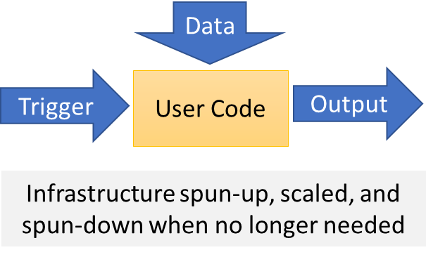
Serverless Computing
Abstracts servers, infrastructure, and operating systems
Reacts to events and triggers in near-real time
Offers a range of benefits:
Eliminates management overhead
Allows developers to focus on business logic
Implements flexible scaling
Reduces costs

Slide 27
Serverless Applications
Compute:
Azure Functions
Cloud Messaging:
Event Grid
Service Bus
Workflow Orchestration:
Logic Apps

Slide 28
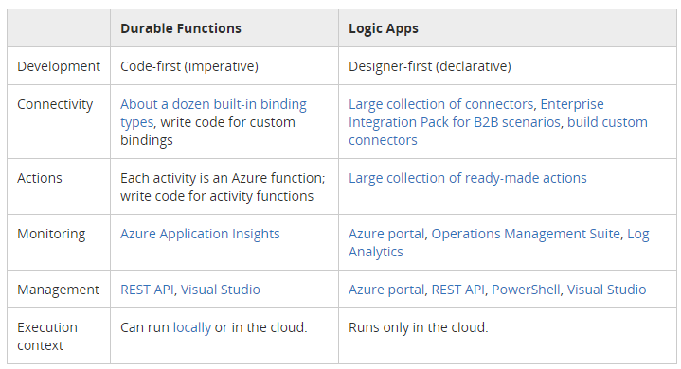
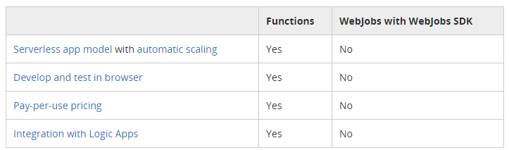
Comparing Serverless Options
Azure Functions vs Logic Apps:
Azure Functions and WebJobs:

Slide 29
Lesson 5: Managing Azure Functions
Video: Azure Functions
Overview of Azure Functions
Features of Azure Functions
Azure Functions (Examples)
Function Service Plans
Function Templates
Implementing Functions
Bindings
Function Scaling
Demonstration: Azure Functions
Practice: Blob Storage Functions
Practice: Timer Functions

Slide 30
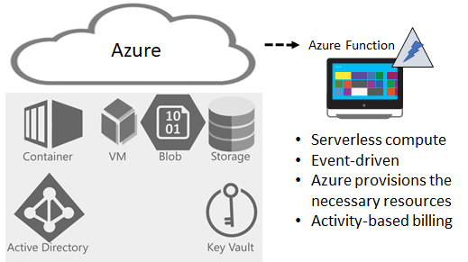
Overview of Azure Functions
Serverless compute service:
Eliminates the need to explicitly provision or manage infrastructure
Enables running code on-demand or in response to a trigger
Incurs charges only when active

Slide 31
Features of Azure Functions
Support for a range of programming languages:
C#, F#, Node.js, Python, PHP, batch, bash, or any executable.
Pay-per-use pricing model
Support for custom dependencies:
NuGet and NPM-based libraries.
Integration with the most popular OAuth providers:
Azure AD, Facebook, Google, Twitter, and Microsoft Account.
Integration with other Azure services and SaaS apps.
Flexible development:
Directly from the Azure portal
Via continuous integration through GitHub, VSTS, and other supported development tools.
Open-source: available on GitHub.
Ease of code reuse:
Developers can reuse their functions in multiple applications.

Slide 32
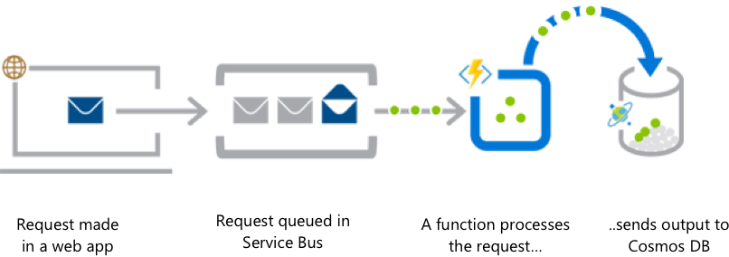
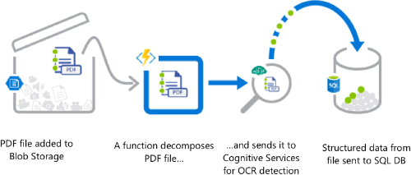
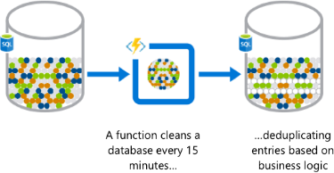
Azure Functions (Examples)
Web app backend
Real-time file processing
Automation of scheduled tasks

Slide 33
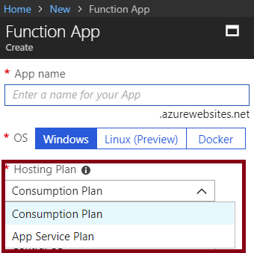
Function Service Plans
Hosting plans:
Consumption Plan:
Azure provides all the necessary compute resources on-demand
Automatic scaling of CPU and memory
Billing is based on:
number of executions
execution time
memory used.
App Service Plan:
The same resource and billing model as for web, mobile, and API apps
Allows for leveraging underutilized App Service deployments
Required for Linux-based function apps

Slide 34
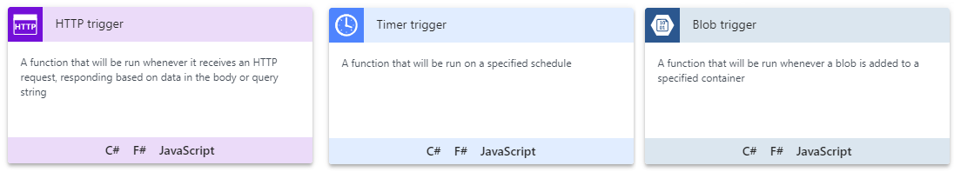
Function Templates
Simplify creating functions for a specific trigger type:
HTTP
Timer
Blob
Event Hub
GitHub
Webhook
Queue

Slide 35
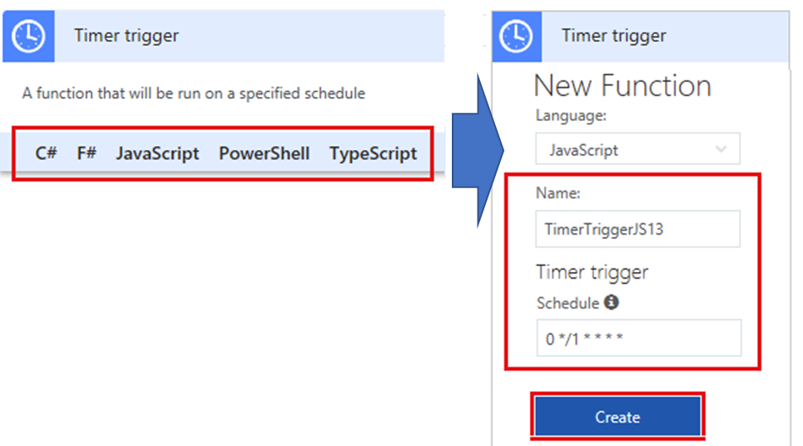
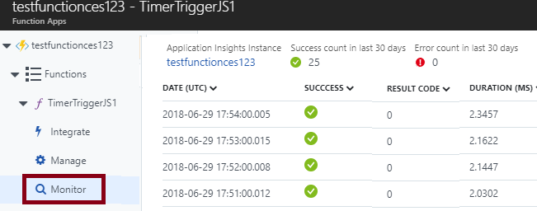
Implementing Functions
In-portal authoring
In-portal monitoring

Slide 36
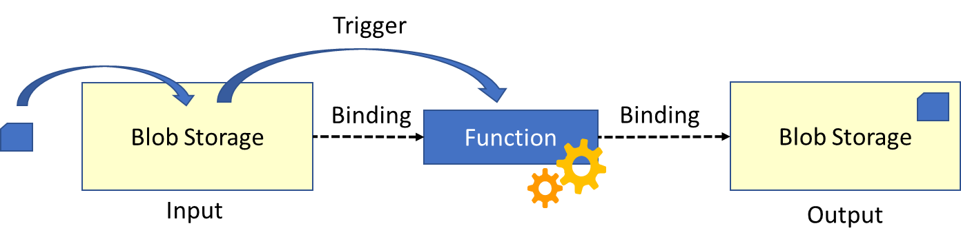
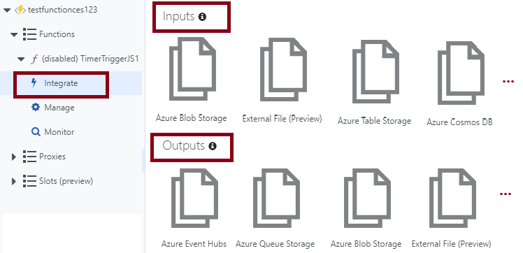
Bindings
Link functions to other services as:
Inputs
Outputs
Configurable in the Azure portal:
Accessible via the Integrate link

Slide 37
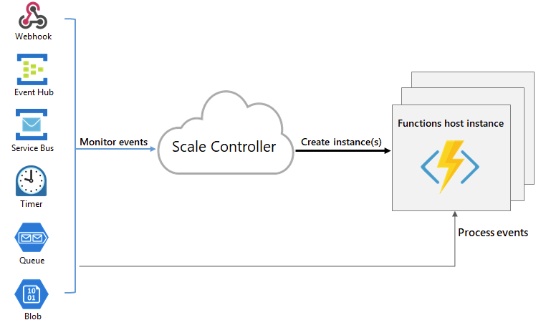
Function Scaling
Relies on the platform-managed Scale Controller
Scale Controller:
Monitors the rate of events
Controls horizontal scaling
Relies on heuristics:
E.g. for Queue Storage trigger:
The queue length
The age of the oldest message

Slide 38
Logic Apps
Implement scalable integrations and workflows
Include a visual designer to model workflows
Offer built-in connectors for cloud and on-premises services and apps
Provide a range of benefits, including:
Getting started quickly from templates.
Saving time by designing complex processes using easy to understand design tools.
Implementing patterns and workflows seamlessly, that would otherwise be difficult to implement in code.
Customizing your logic app with your own custom APIs, code, and actions.
Connecting and synchronizing disparate systems across on-premises and the cloud.

Slide 39
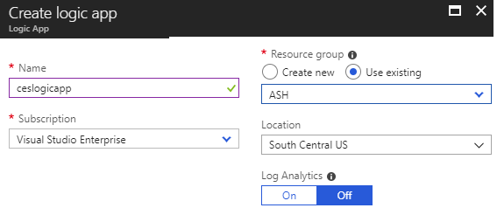
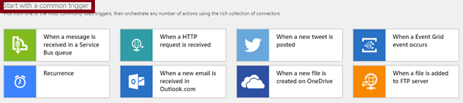
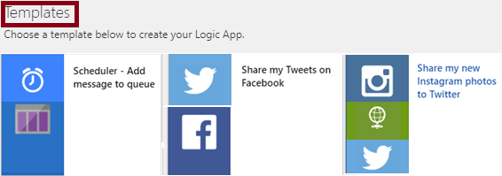
Implementing Logic Apps
From the Azure portal:
To create a logic app, provide:
Name
Subscription
Resource Group
Location
To configure a logic app:
Use the Logic Apps Designer to:
Add triggers
Add connectors
Leverage templates

Slide 40
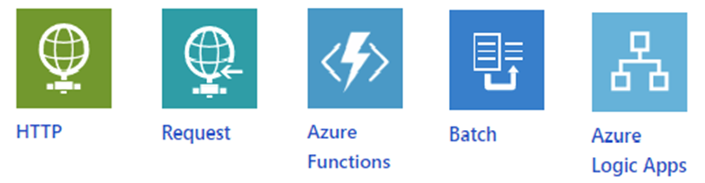
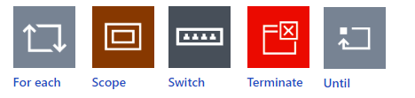
Built-in Triggers and Actions
Triggers:
Recurrence
HTTP
Request
Azure Functions
Batch
Logic Apps
Actions:
Condition
For each
Scope
Switch
Terminate
Until

Slide 41
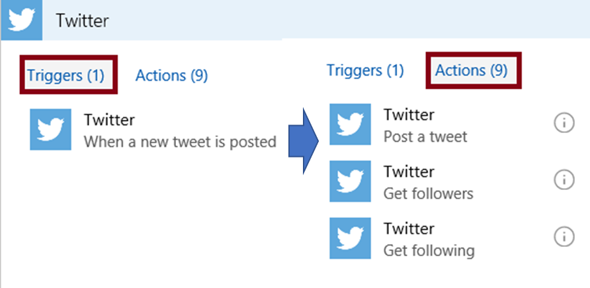
Managed Connectors
200+ built-in connectors, including:
Managed API connectors:
Azure Blob Storage, Office 365, Dynamics, Power BI, OneDrive, Salesforce, and SharePoint Online.
On-premises connectors:
SQL Server, SharePoint Server, Oracle DB, Twitter, Salesforce, Facebook, and file shares.
Integration account connectors:
Require a paid-for integration account
Transform and validate XML
Encode and decode flat files
Process B2B messages
Enterprise connectors:
Incur extra cost
Provide access to enterprise systems:
Support SAP and IBM MQ.

Slide 42
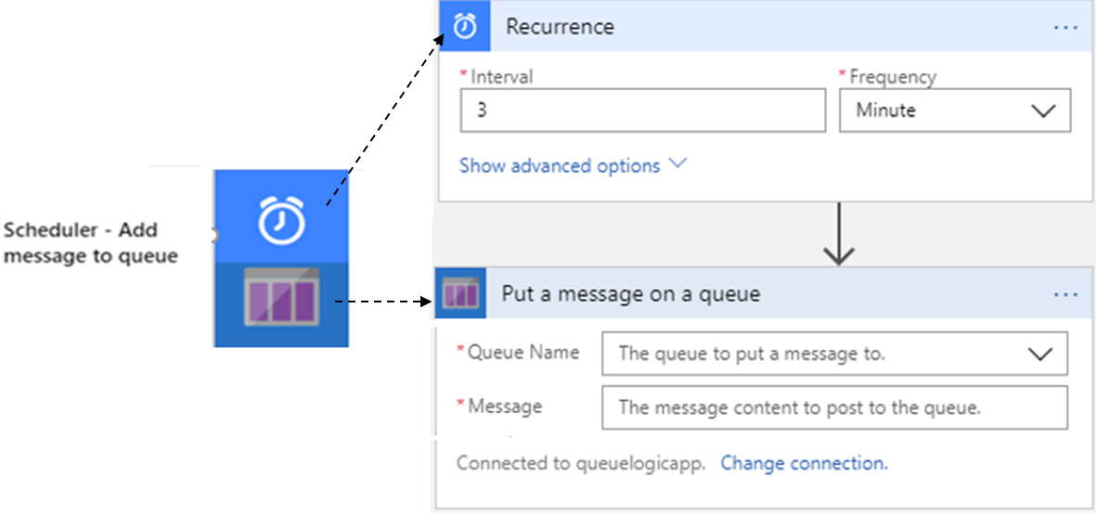
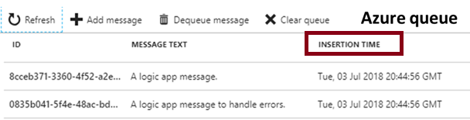
Logic App Example
The Scheduler logic app consists of:
Recurrence:
Controls scheduling
Put a message on a queue:
Designates the target Storage queue

Slide 43
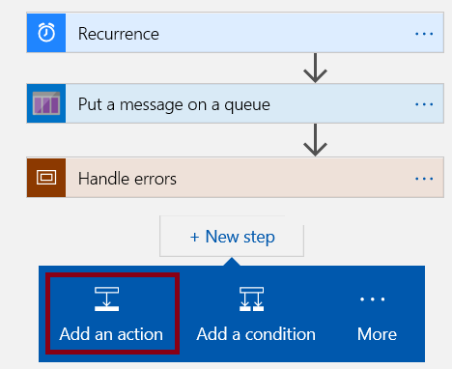
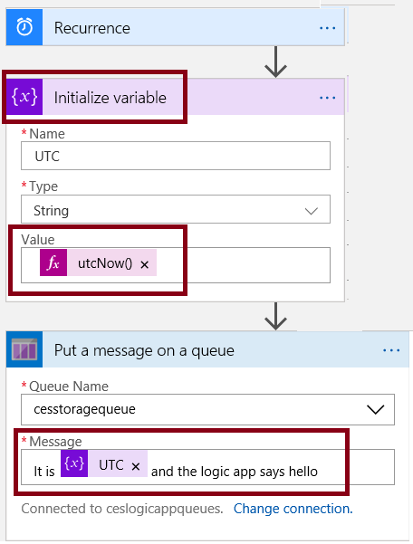
Logic App Example (cont.)
To customize the workflow:
Add a extra action:
Variable (Initialize Variable)
Modify the action sequence
Add variable to the message

